Slide 1
Oplæg for gymnasielærere på Introduktion til programmering
7. maj 2021
Informatik
Didaktik | Teknologiforståelse | Fagligt samspil
Michael E. Caspersen
Direktør, It-vest – samarbejdende universiteter
Adjungeret professor, Institut for Datalogi, Aarhus Universitet
mec@it-vest.dk

Slide 2
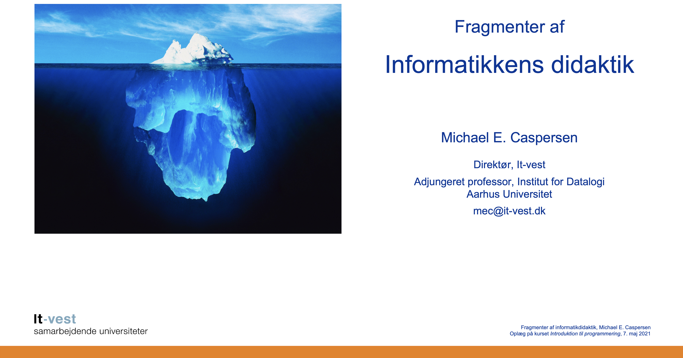

Slide 3
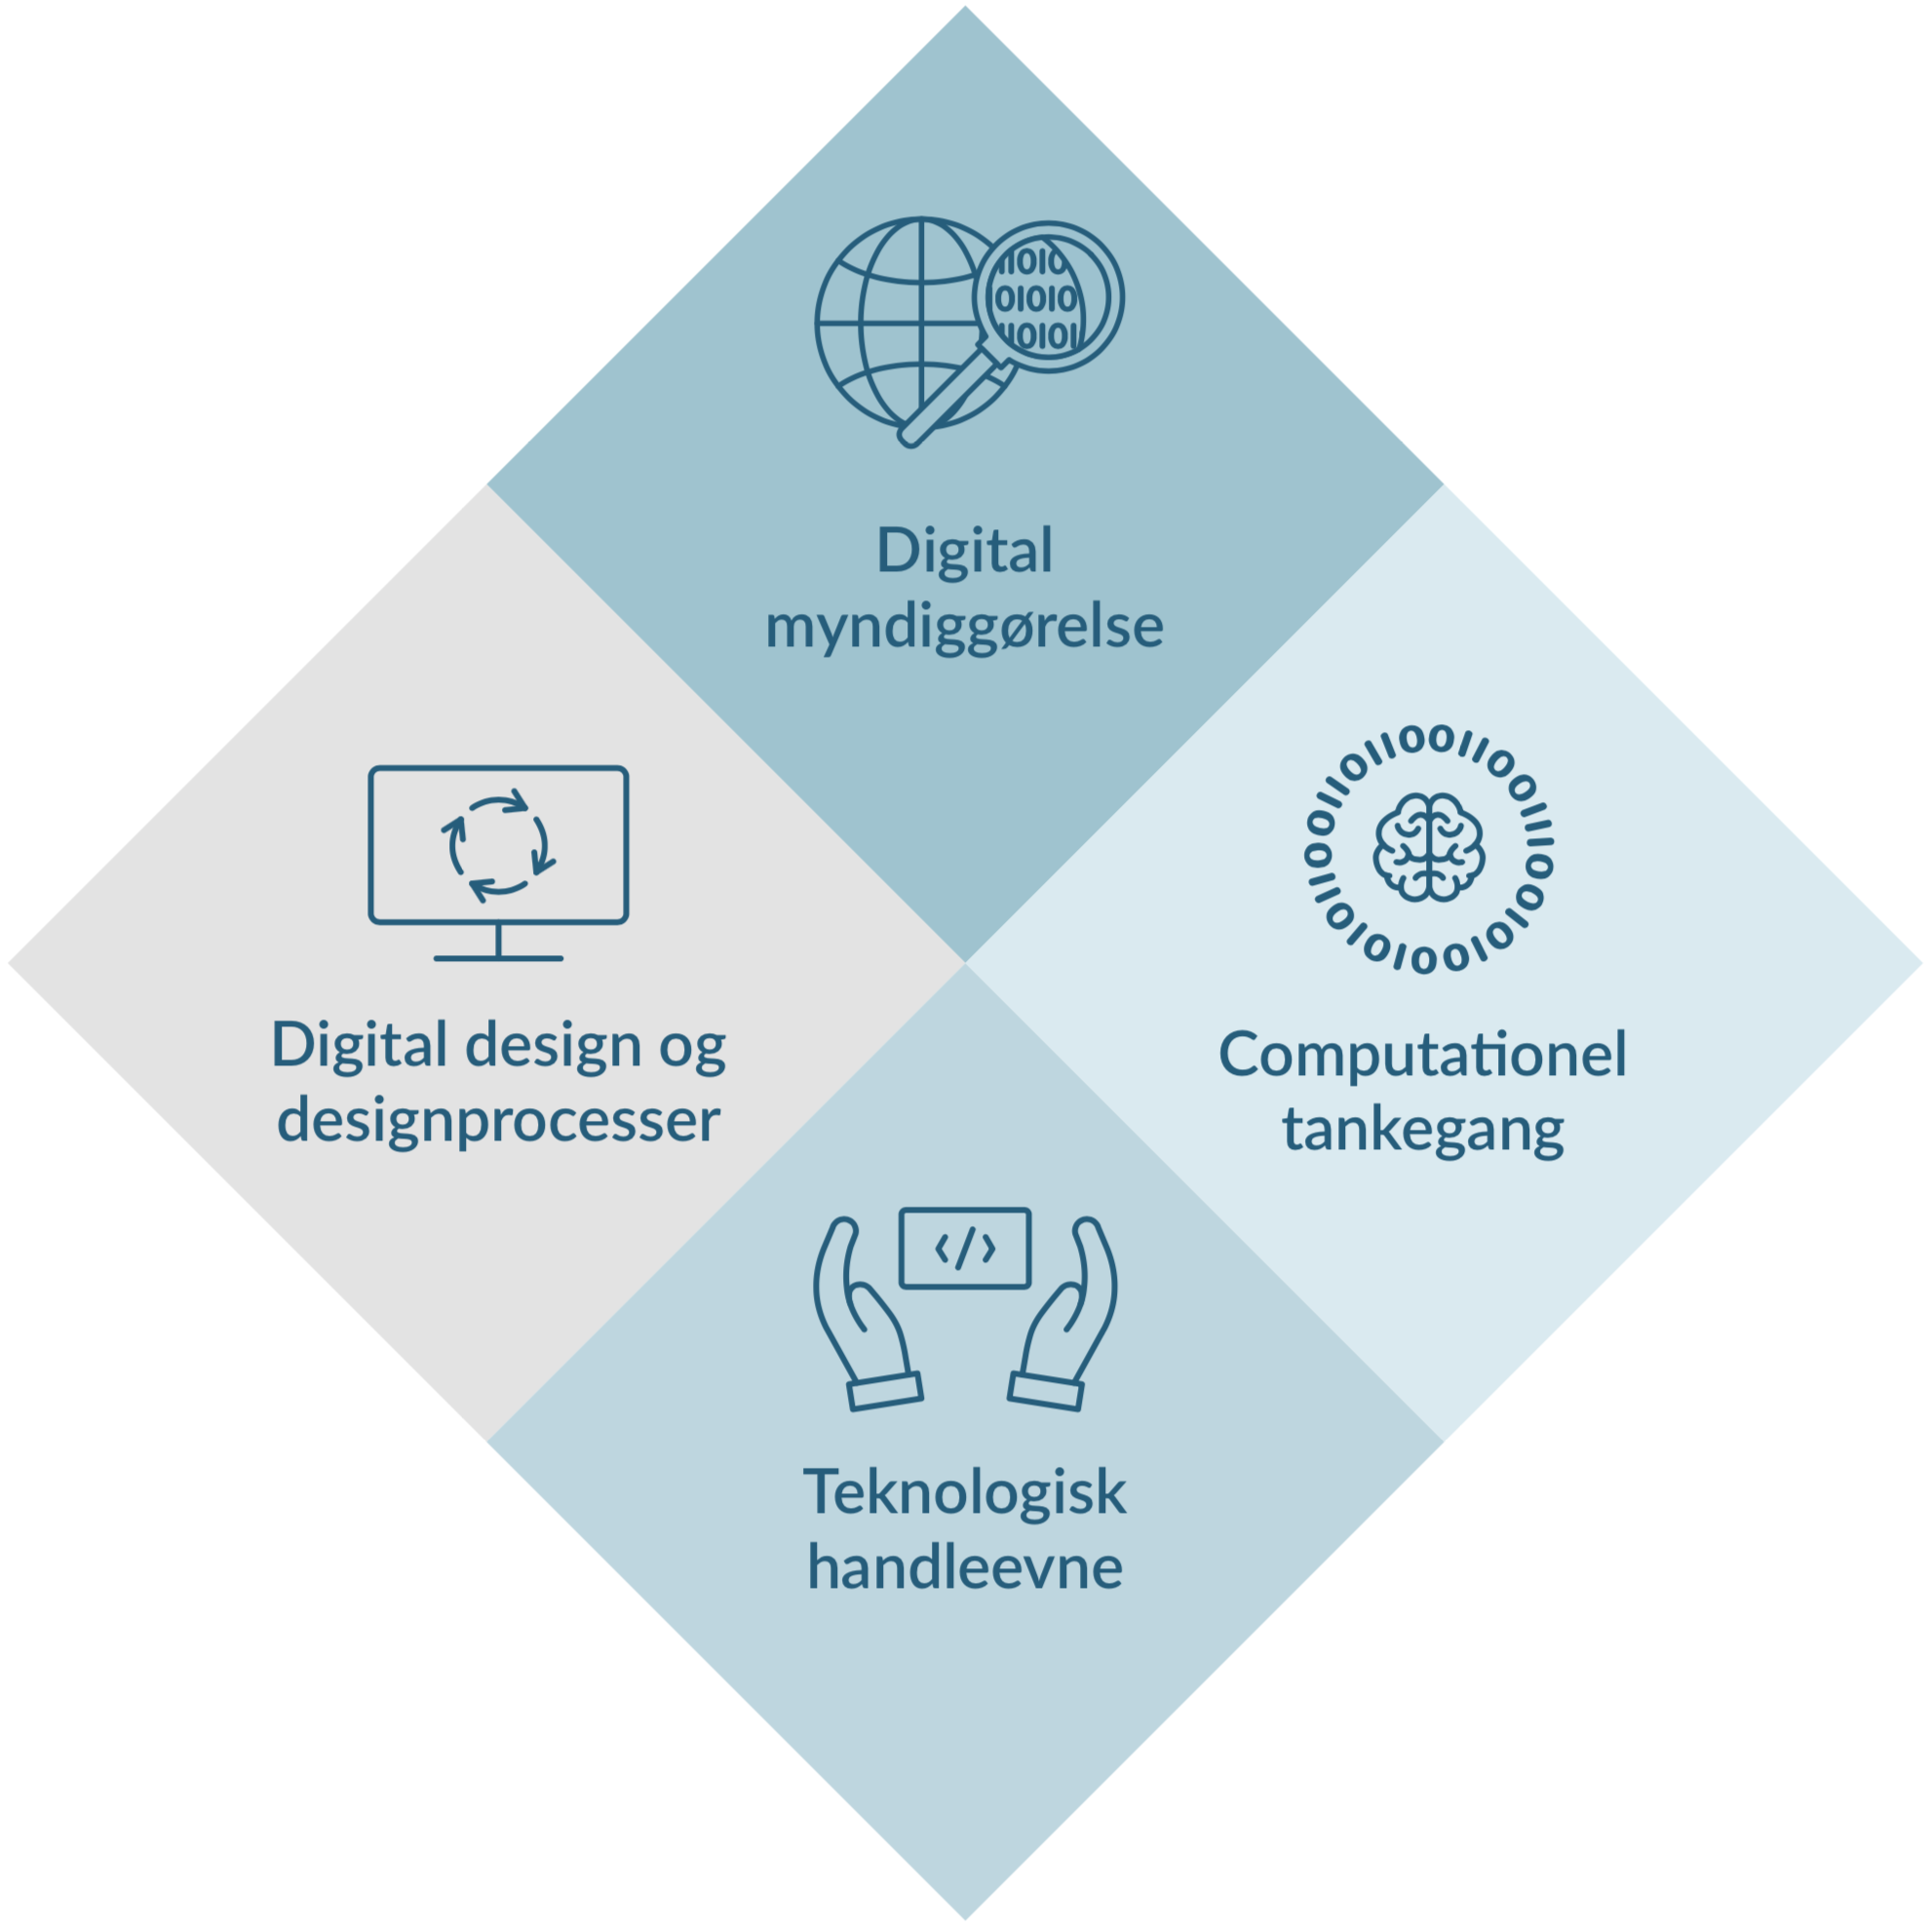
Teknologi- forståelse

Slide 4

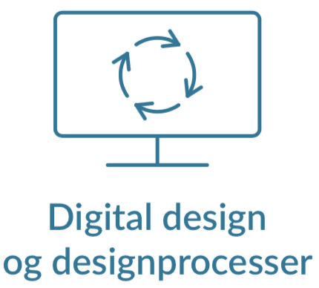
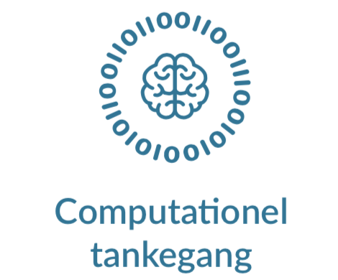
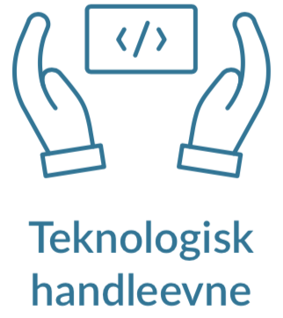
De fire kompetenceområder
Digital myndiggørelse
Kritisk, refleksiv og konstruktiv undersøgelse og forståelse af digitale artefakters muligheder og konsekvenser.
Analyse af teknologi, formål og brug | Konsekvensvurdering | Redesign
Digital design og designprocesser
Tilrettelæggelse og gennemførelse af iterative designprocesser under hensyntagen til
fremtid brug.
Rammesættelse| Idégenerering | Konstruktion | Argumentation og introspektion
Computationel tankegang
Analyse, modellering og strukturering af data og dataprocesser med henblik på automatisk udførelse af en computer.
Data | Algoritmer | Strukturering | Modellering
Teknologisk handleevne
“Mestring” af digitale teknologier (computersystemer, netværk og sikkerhed) og tilhørende sprog samt programmering.
Programmering | Computersystemer | Netværk | Sikkerhed
Notes:
The Danish Informatics curriculum for primary and lower secondary school consists of four competence areas:
- Digital empowerment
- Digital design and design processes
- Computational thinking and modelling, and
- Technological knowledge and skills.
The two latter encompass traditional computing subjects, while the two former are less standard in Informatics curricula – if present at all.
Inclusion of Digital design and design processes recognise the bipartite nature of all computation that is directed at purposes in the real world.
Thus, we embrace both problem domain and solution domain – the entire bipartite system. Both the software machine and the physical (or imaginary) world whose behaviour it governs.
This is not generally embraced in curricula for computing in school. The focus on design process is inspired by the Scandinavian school of Participatory Design, which originated in the 1960s and 1970s, and by Donald Schön’s philosophy of design as a reflective practice from the 1980s. The particular notion of problem framing and reframing are essential parts of this and is also inspired by the seminal work of British computer scientist Michael Jackson in the 1990s.
Another unique – I think – component of our curriculum is Digital empowerment, which represents the ability to analyse and evaluate digital artefacts with a focus on intention and use through a critical, reflexive and constructive examination and understanding of consequences and possibilities of a digital artefact.
This is for digital artefacts what literature analysis is for novels, but with the additional liberating component of reframing and redesign – realising that digital artefacts are human-made and could have been designed differently if other perspectives had been applied.

Slide 5
Computationel modellering af et problemdomæne
Begreber og brugssituationer
Digital
teknologi
Computationel
modellering
Analyse og abstraktion
Design og konstruktion
Værdi gennem brug
og fortolkning
Fænomener og
komplekse problemer
Digitale
artefakter
Problemdomæne
Computationelt modelsystem
Notes:
The four competence areas constitute a holistic approach to Informatics, which I will describe in terms of this model of computational modelling. ;-)
The real or an imaginary world is populated with phenomena and activities, which – through analysis and abstraction – can be understood in terms of concepts and use cases.
Through computational modelling, these can be prioritised, structured and modelled for computational representation. Through design and construction using digital technology, new digital artefacts can be developed to manipulate and transform these representations into something, which hopefully provides value through interpretation and use back in the real world.

Slide 6
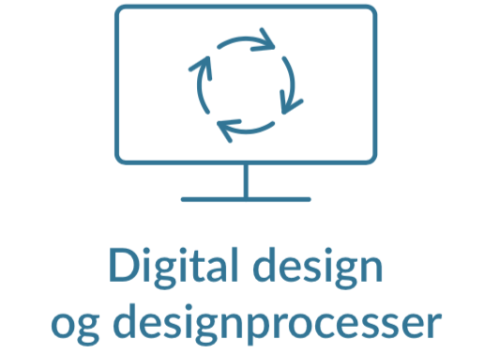
Teknologiforståelse
Begreber og brugssituationer
Digital
teknologi
Computationel
modellering
Analyse og abstraktion
Design og konstruktion
Værdi gennem brug
og fortolkning
Fænomener og
komplekse problemer
Digitale
artefakter
Problemdomæne
Computationelt modelsystem
Notes:
The four competence areas maps – more or less 1-1 – to the four processes in the model.
[Shift to 28a – animation]
Digital design and design processes covers primarily activities related to the problem domain.
[Shift to 28b – animation]
Computational thinking and modelling maps to the process going from problem domain to the computational model system.
[Shift to 28c – animation]
Technological knowledge and skills provide competences to design and construct digital artefacts
[Shift to 28d – animation]
Digital empowerment relates to the process back from the computational model system to the problem domain.
Not only does the four competence areas constitute a nice, full circle. They also mutually strengthen each other.
Analytical competences provided by Digital empowerment will strengthen the three other competence areas. And vice versa: if you actually know how to build digital artefacts, your critical and constructive analysis can become much richer and deeper.

Slide 7

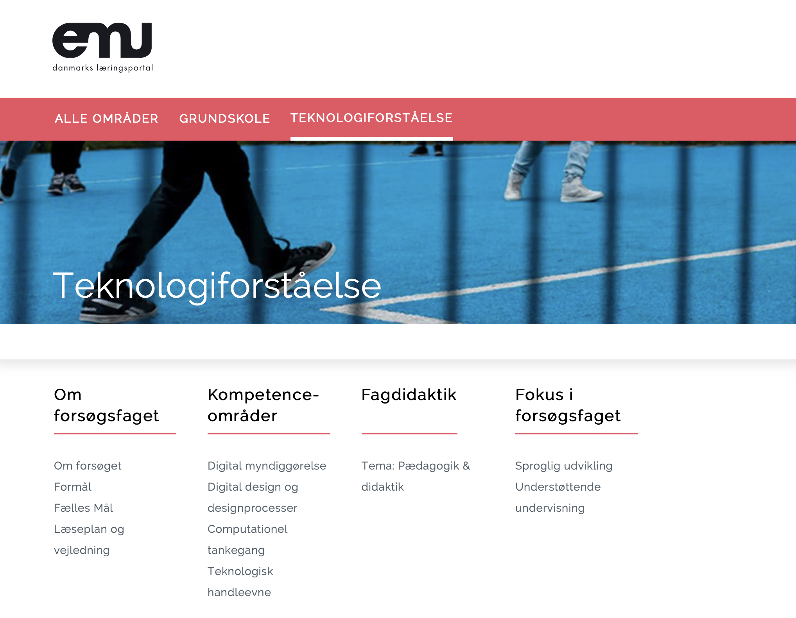

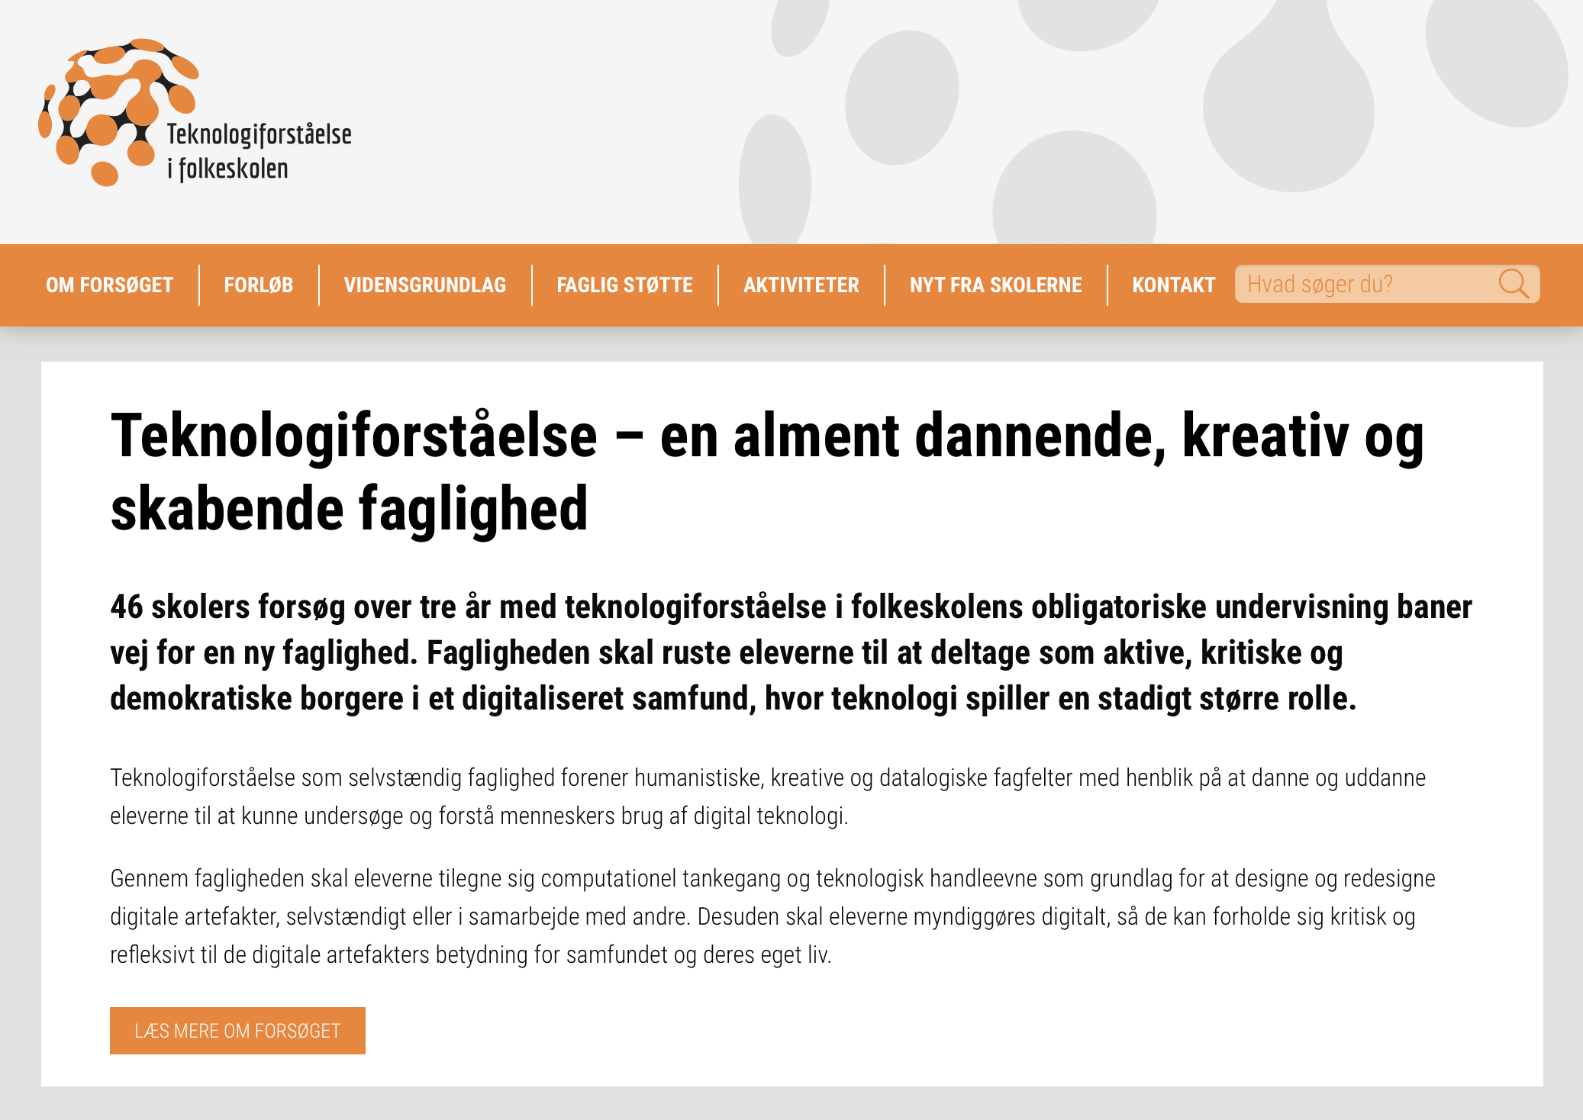
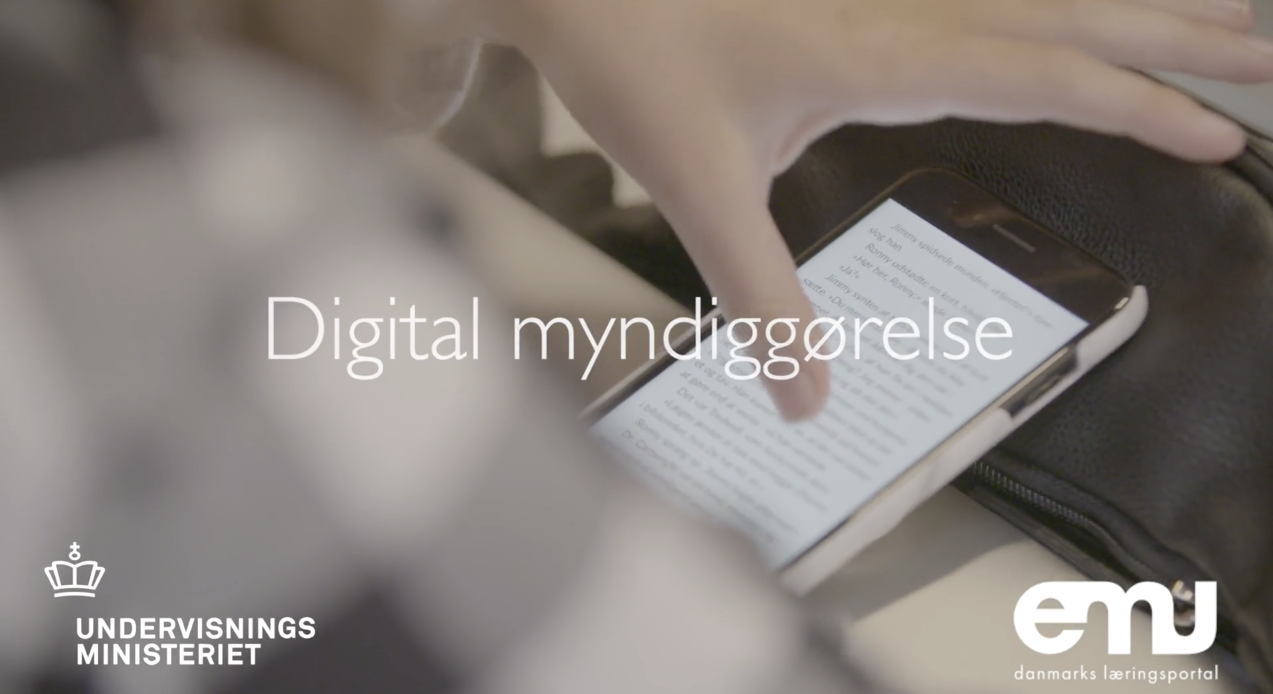
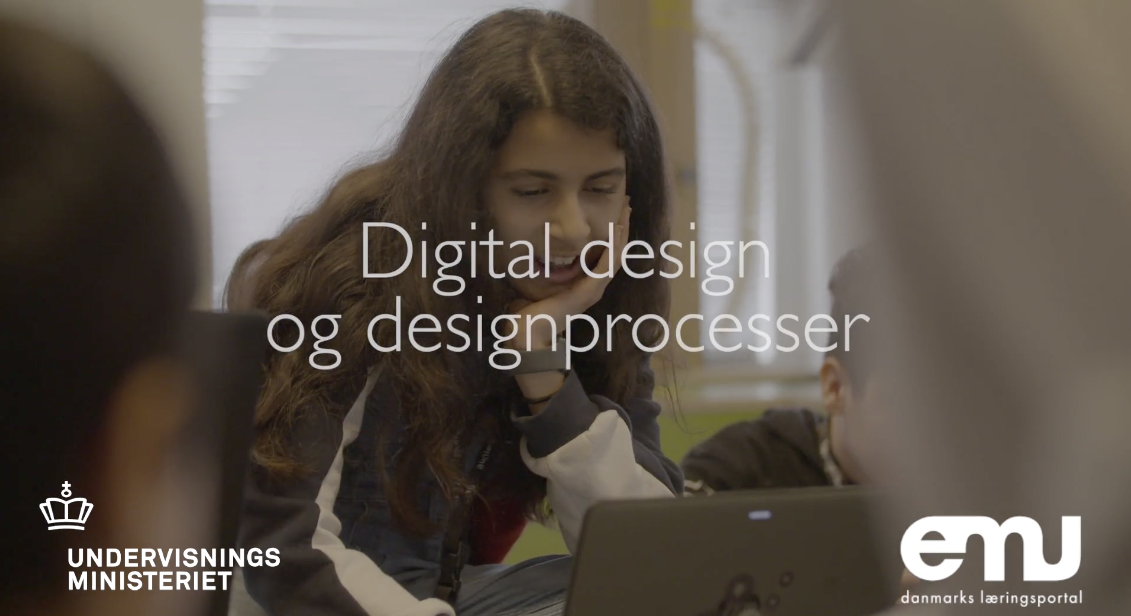
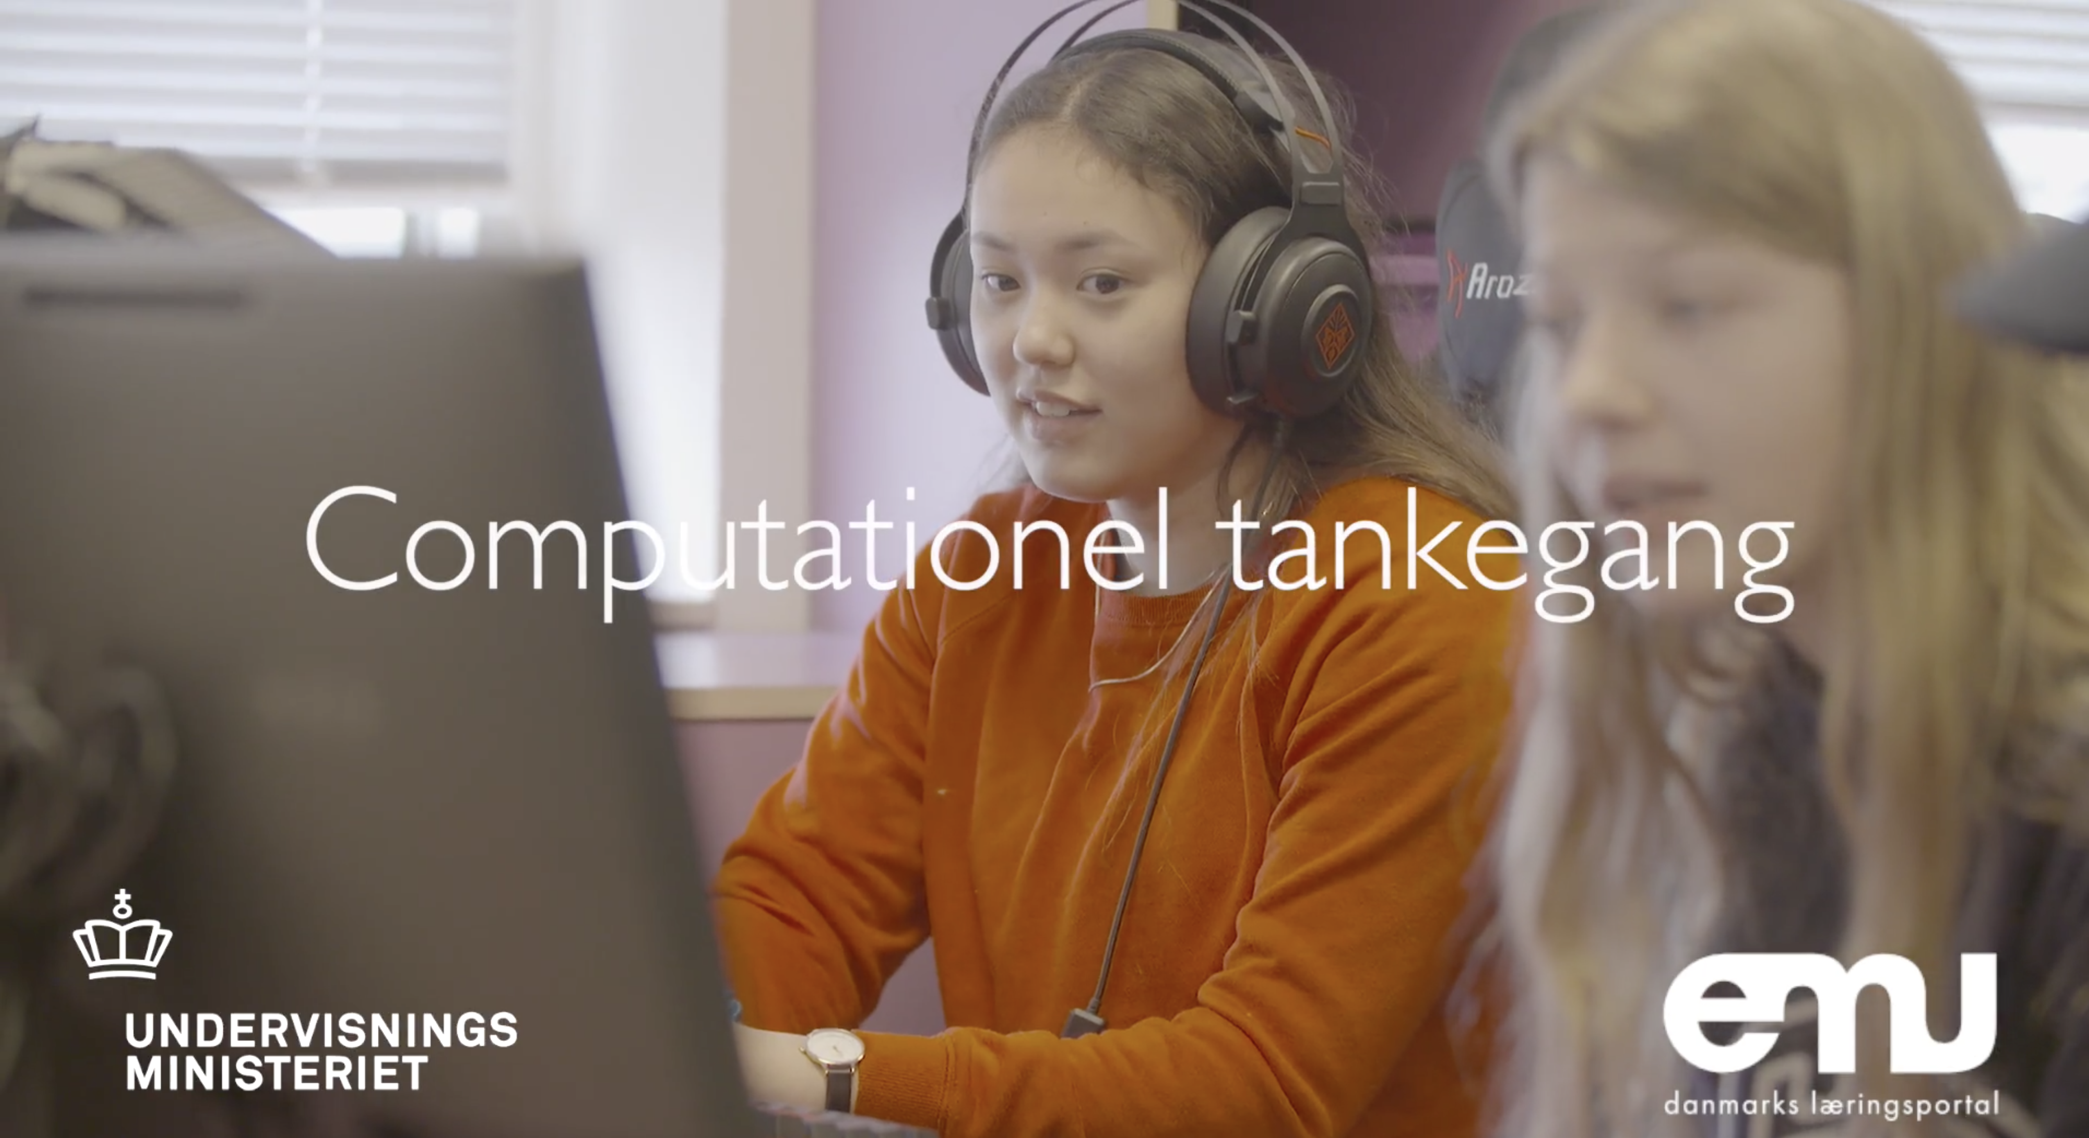
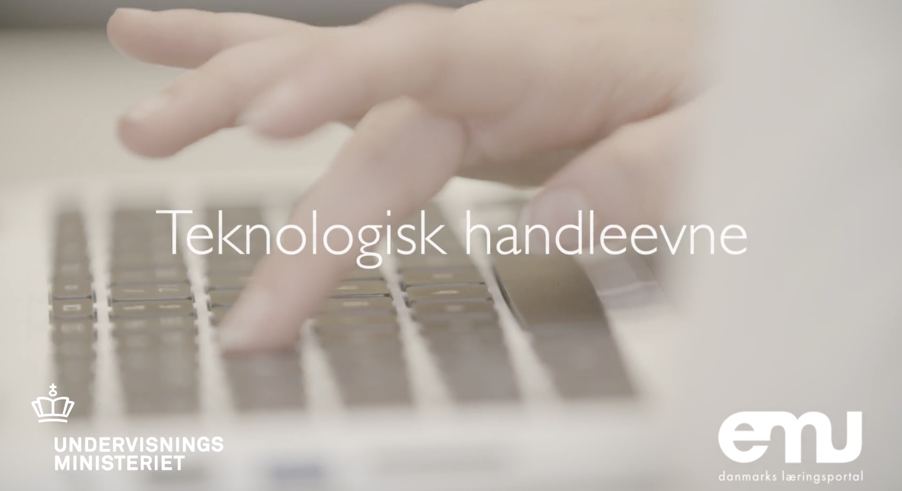
Ressourcer om teknologiforståelse

Slide 8
Afprøvning og evaluering af to/tre modeller
Afprøvning som selvstændigt fag
Politisk afgørelse
forligskredsen
Fagudvikling og formulering af
Fælles Mål
Kombi-model (afprøves ikke, men evalueres!)
Afprøvning i eksisterende fag
Evaluering
2018
2019-2021
2021 (?)

Slide 9
Fagligt samspil

Slide 10
Vision/strategi
Informatik – et alment dannelsesfag
og en fundamental kompetence for alle
Tysk
...
Filosofi
Musik
Billedkunst
Informatik
Design
Geografi
Økonomi
Samfundsvidenskab
Engelsk
Psykologi
Geologi
Marketing
Spansk
Biologi
Literatur
Kemi
Historie
Fysik
Oldtidskundskab
Kinesisk
Bioteknologi
Sprog
Informatik
Matematik
Matematik er (primært) naturvidenskabernes sprog
Informatik er et sprog for alle fag og discipliner
Notes:
Informatik er ikke blot en sag for specialister.
Informatik, er et nyt dannelsesområde og en ny fundamental kompetence som alle i det 21. århundrede bør udstyres med fra barnsben – helt på linje med at kunne læse, skrive og regne. Intet mindre!

Slide 11
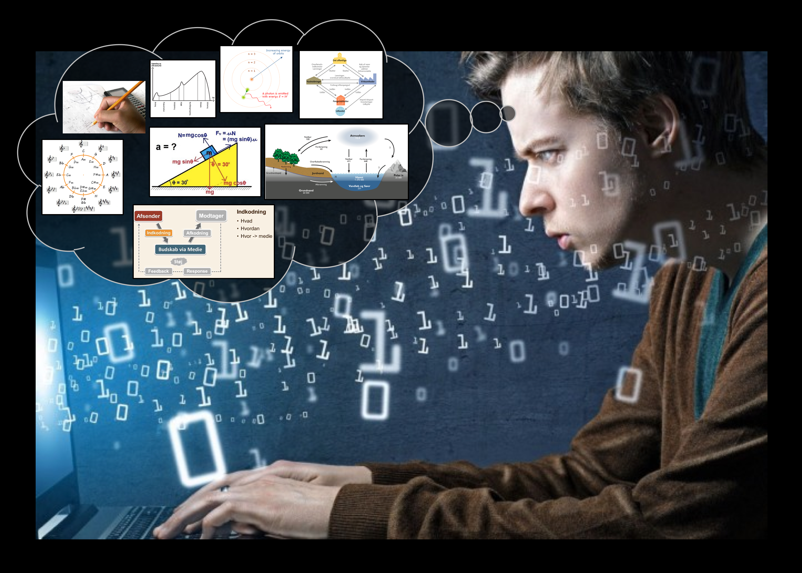
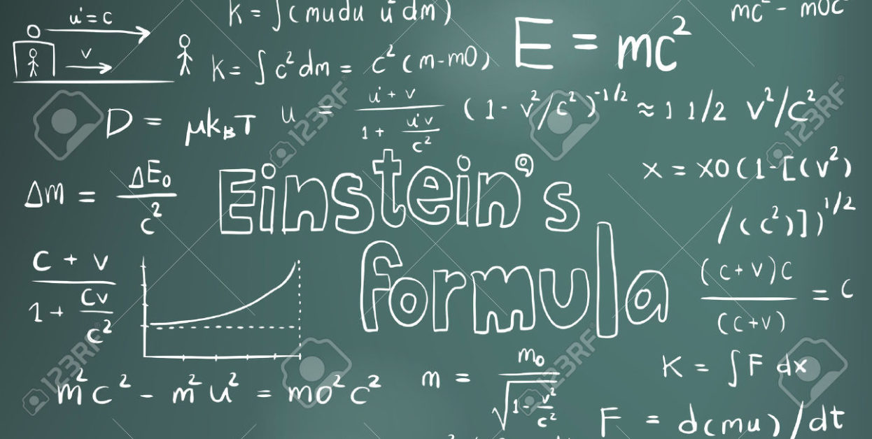
Informatik/CT – et nyt sprog
1. Talesprog
2. Skriftsprog
3. Matematisk sprog
4. Computationelt sprog
=
Det tog menneskeheden 150 år at blive enige om tegnet for lighed
(1557 - 1700)
Notes:
Informatics may be conceived as humankind's fourth major language alongside spoken language, written language and the language of mathematics.

Slide 12

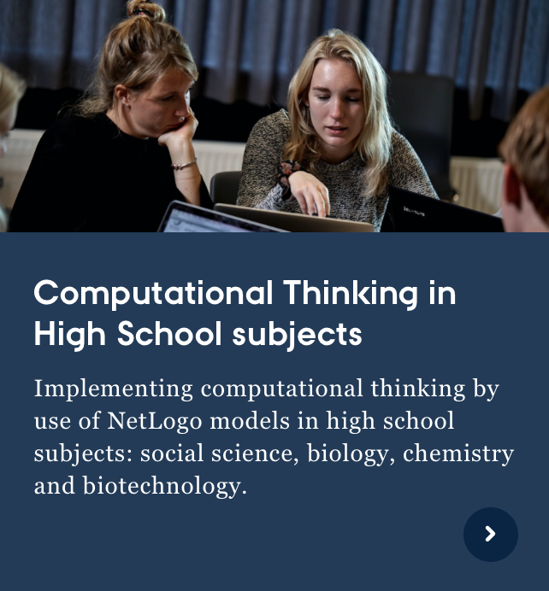
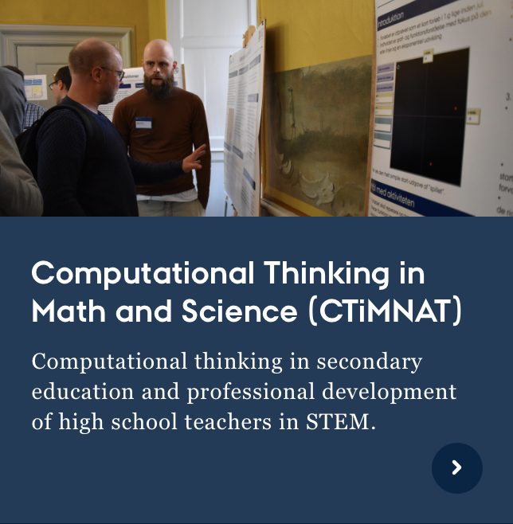
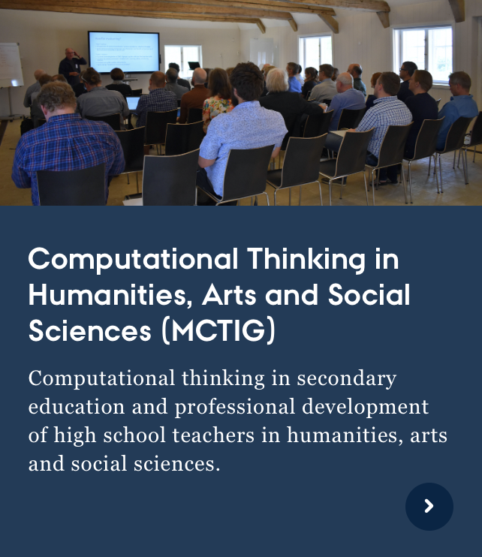
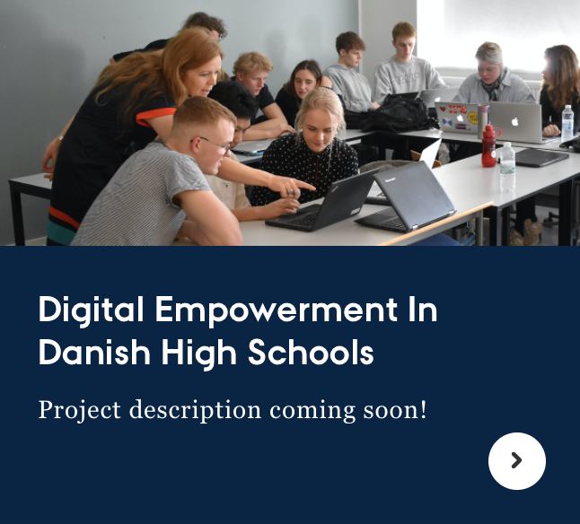
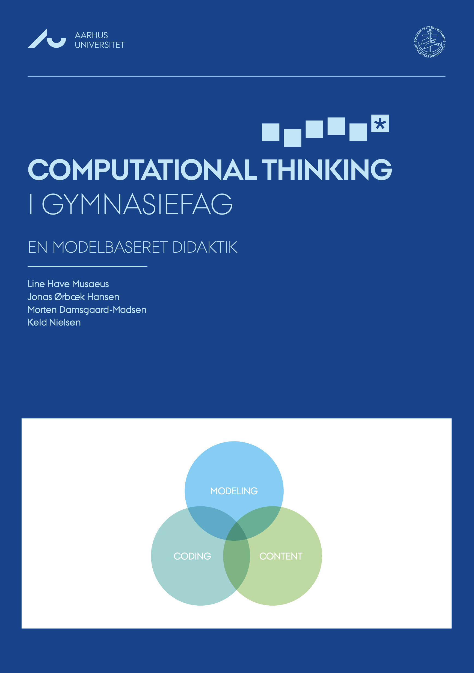
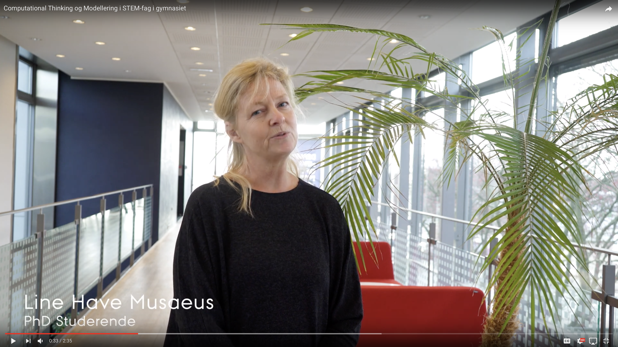
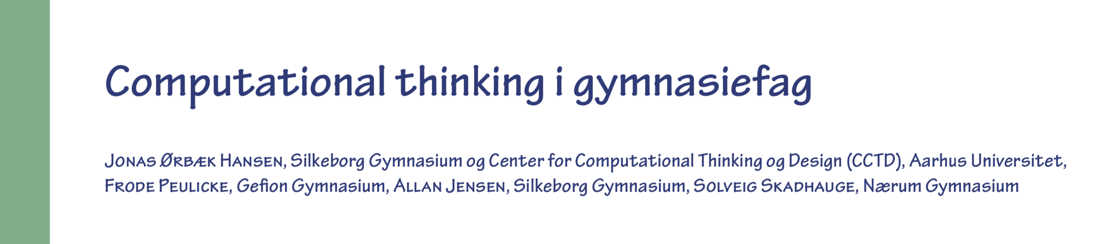
CT i gymnasiefag
2017
2018-2020
2018-2020
2019-2021
2020-2024
…
CT i gymnasiefag
Region Midtjylland
0,5 mio. kr.
CT i mat og nat
VILLUM FONDEN
3,15 mio. kr.
I alt 7,75 mio. kr.
CT i hum og samf
Midtjysk Teknologipagt
2,2 mio. kr.
CT i hum og samf
Midtjysk Teknologipagt
0,6 mio. kr.
Data expeditions @ KU
Novo Nordisk Fonden
6 mio. kr.
Læs om CTiMNAT i LMFK-bladet, februar 2020, i alt 21 sider

Slide 13
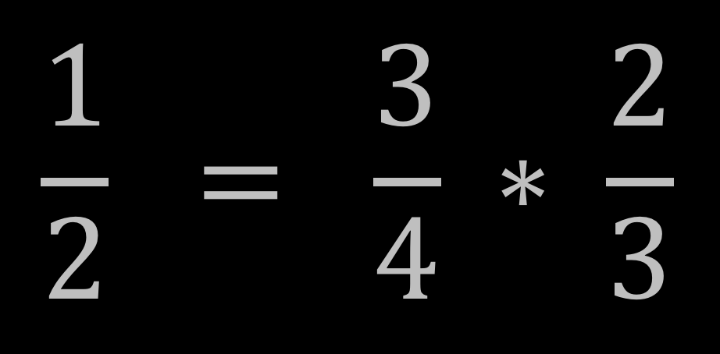
Naturligt vs. matematisk sprog
It is indeed
too odd
for words
that half's
three quarters
of two thirds.
- Piet Hein
Notes:
A new language evolves because it enables simple expression of otherwise complicated matters.
Here is an example of what mathematics enables to express in a simple way compared to written language – illustrated with a so-called Grook by Piet Hein.
It is indeed ...
This is almost impossible to parse and comprehend.
[Shift to 16a – animation]
... but if we express it mathematically, it is trivial to grasp the assertion and to verify its validity.

Slide 14
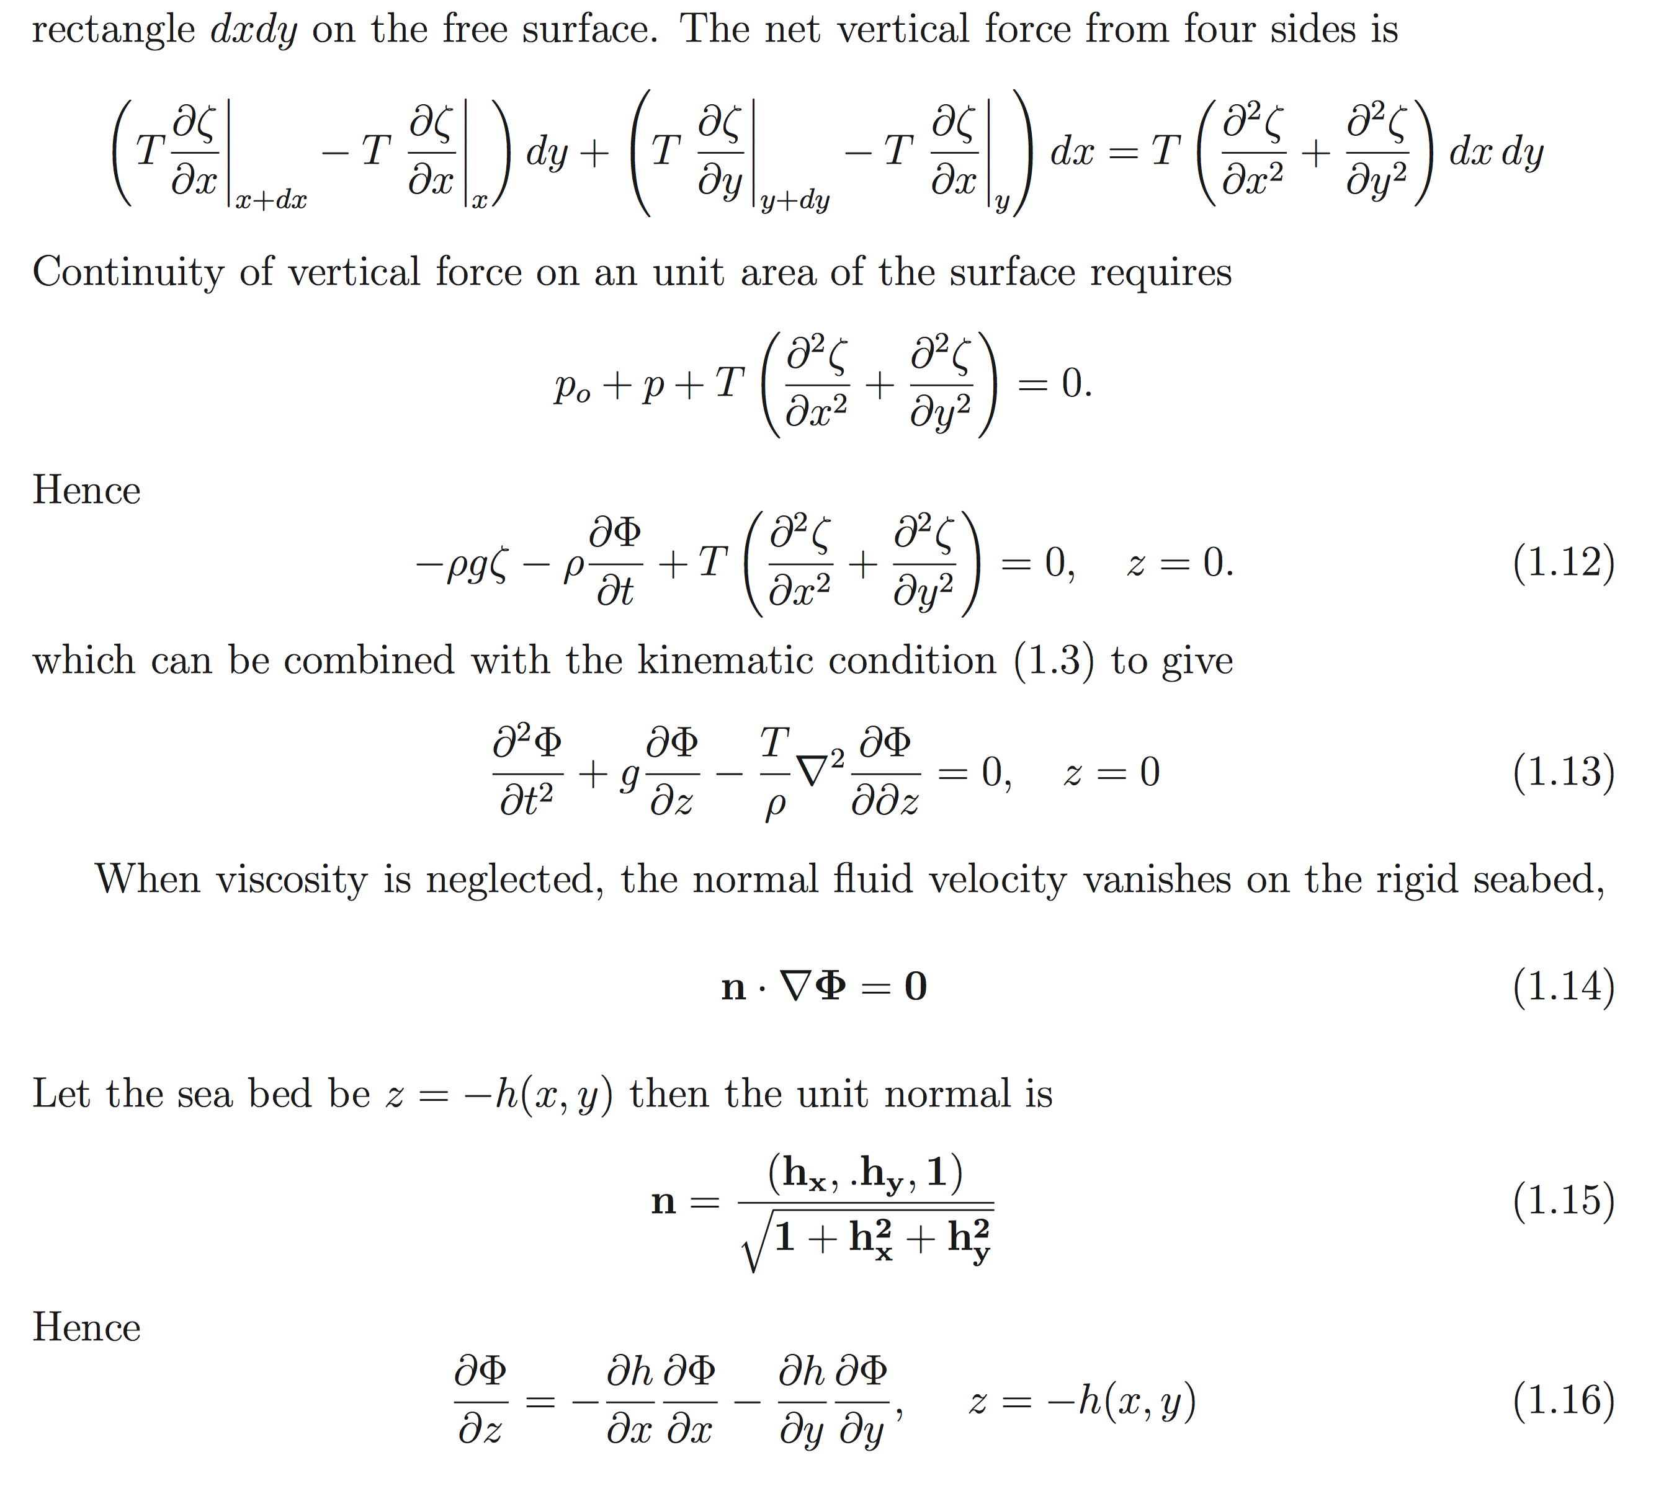
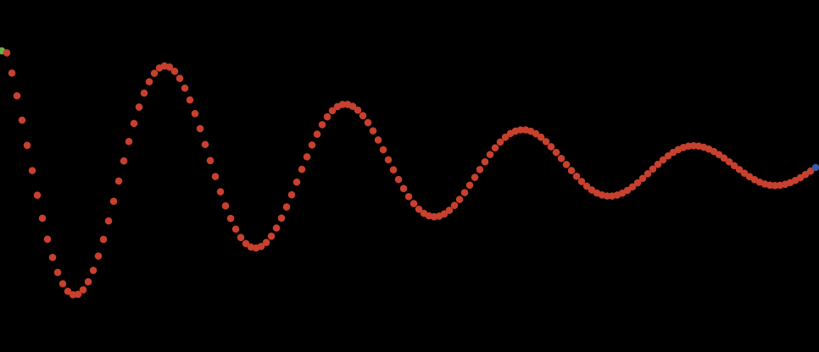
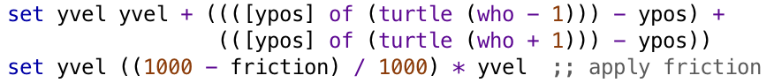
Matematisk vs. computationelt sprog (1)
Bølgemodel
Centralt
Stokastiske metoder, differentialligninger
og mange andre "gode" sager
40 sider ikke-triviel matematik
Decentralt
Simpel lokal regel: (a+b) / 2
Emergens og dynamik "foræret"
Agentbaseret modellering (ABM)
Notes:
A similar relation exists between mathematical and computational language.
Here illustrated by wave modelling.
The traditional approach to wave modelling requires very complicated mathematics in the form of coupled differential equations, and then almost all people are completely lost.
However, a simple computational model can be created, and all it takes – with respect to math – is very basic calculus, namely addition and division by 2.
A decentral agent-based approach to modelling enables creation of transparent computational models of complex dynamic systems which pupils from an early age can comprehend, investigate, modify and so forth.
In this way and in the concrete context of wave modelling, pupils can investigate and gain experience with advanced concepts such as frequency, amplitude, interference, plasticity, etc.

Slide 15
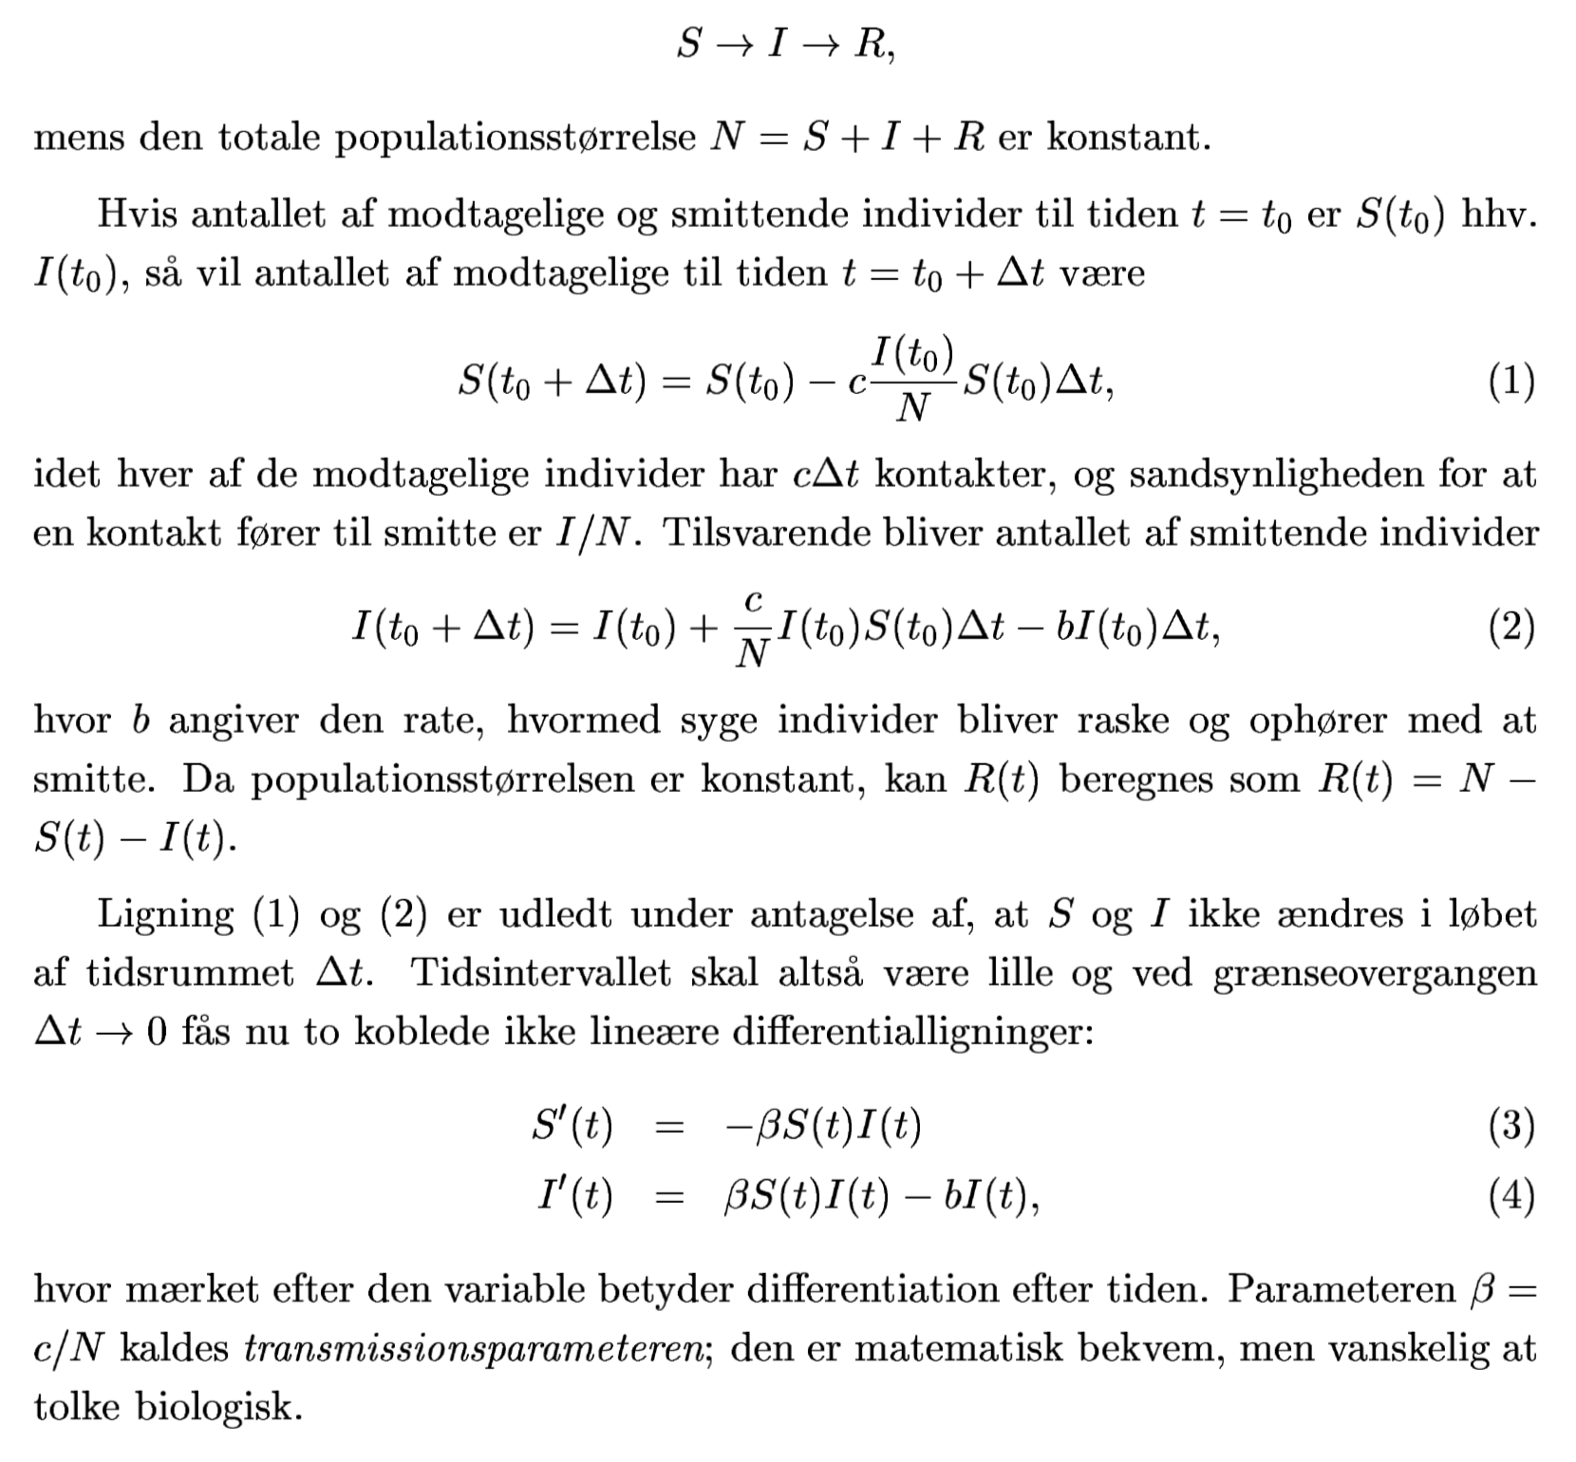

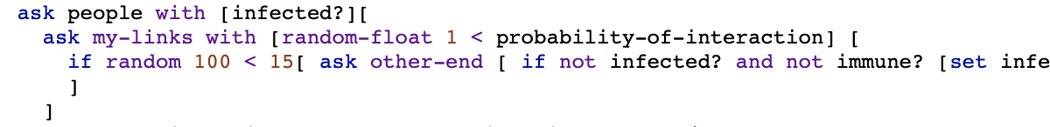
Matematisk vs. computationelt sprog (2)
Epidemimodel
March 14, 2020
Centralt
Stokastiske metoder, differentialligninger
og mange andre "gode" sager
25 sider ikke-triviel matematik
Decentralt
Simpel lokal regel
Emergens og dynamik "foræret"
Agentbaseret modellering (ABM)

Slide 16
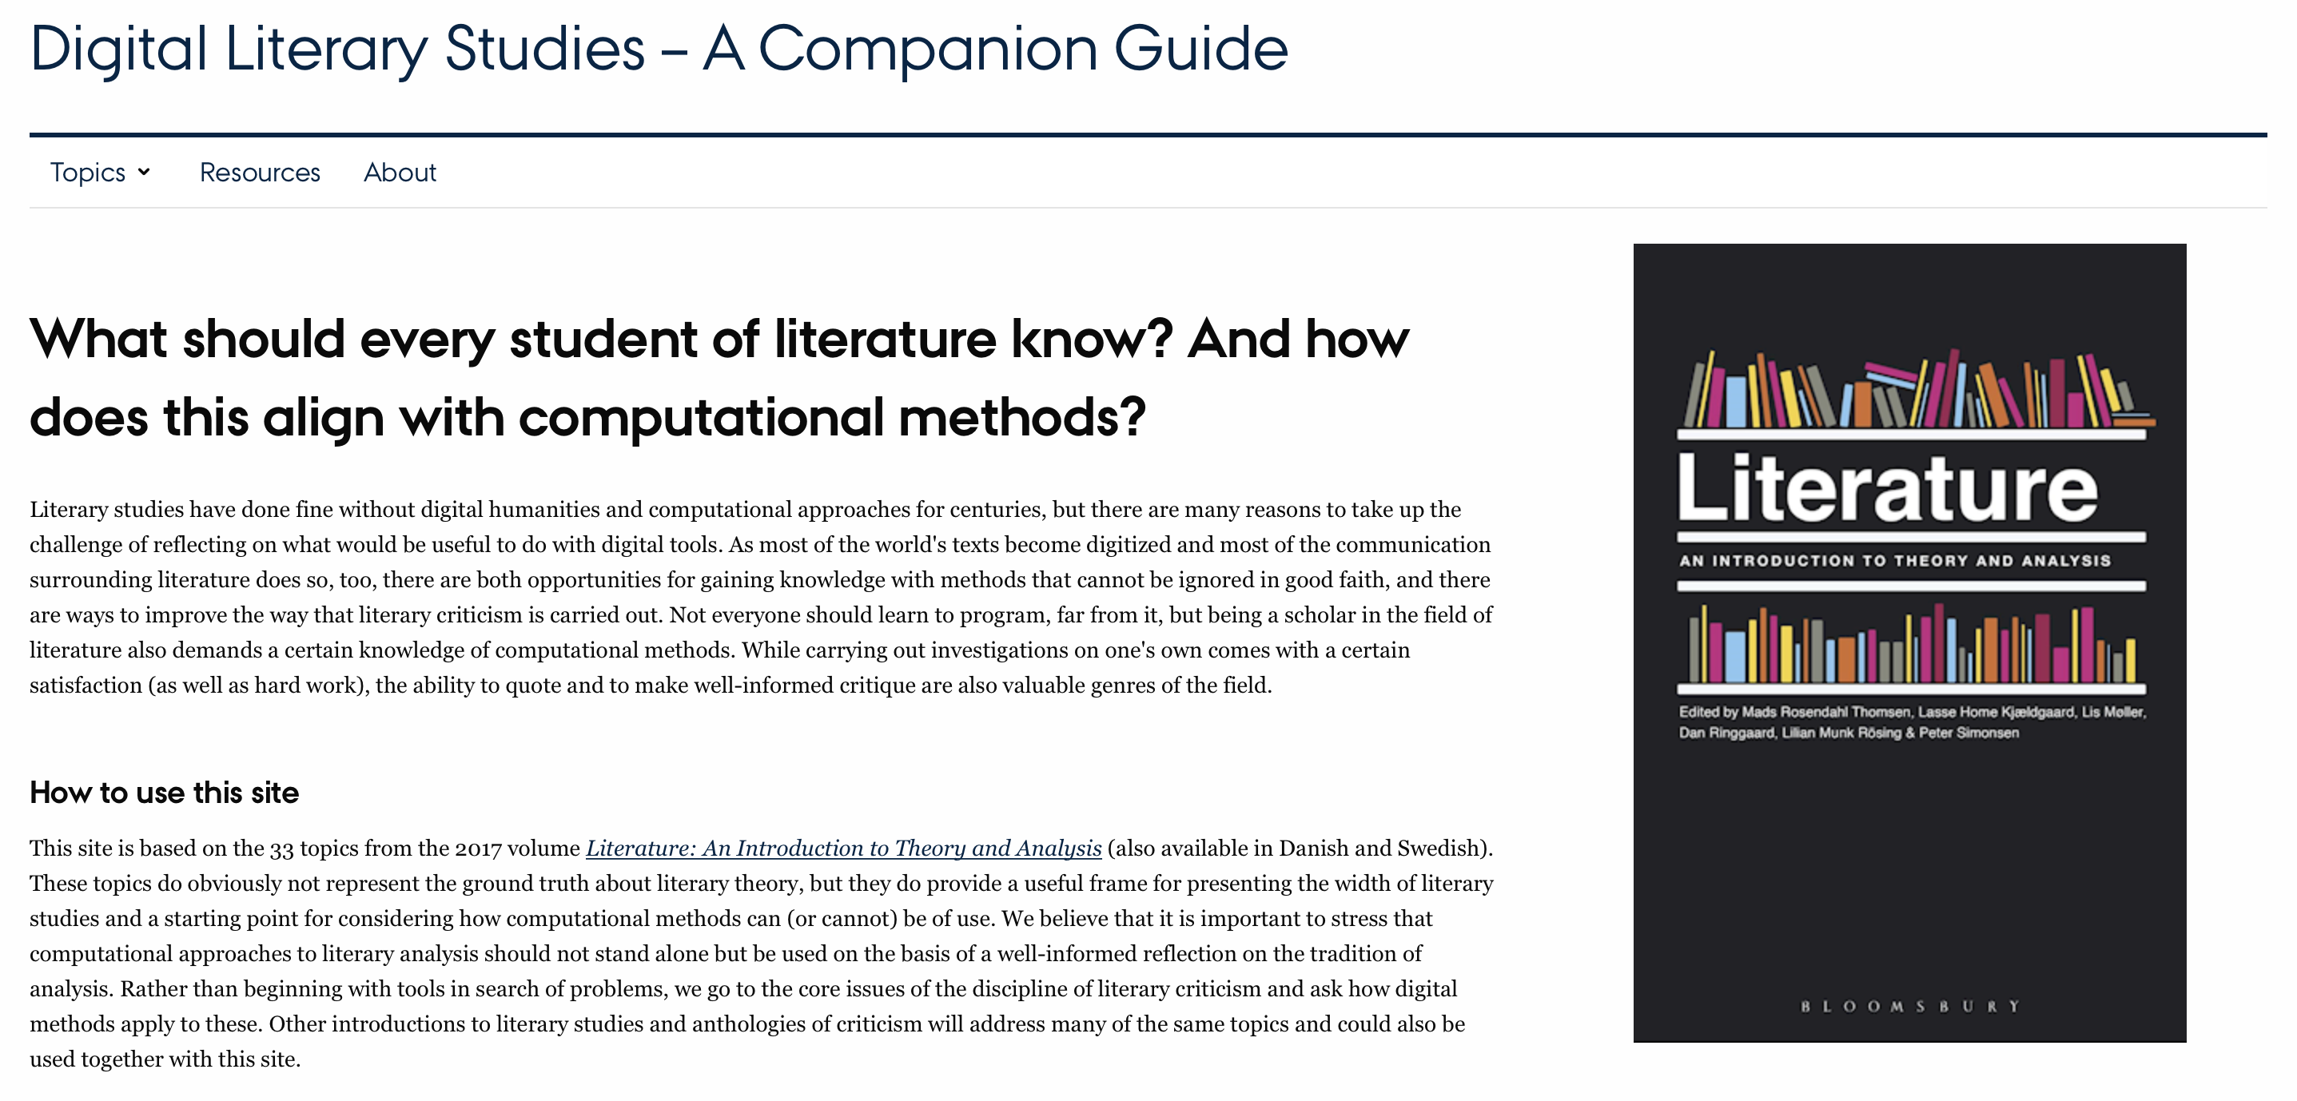
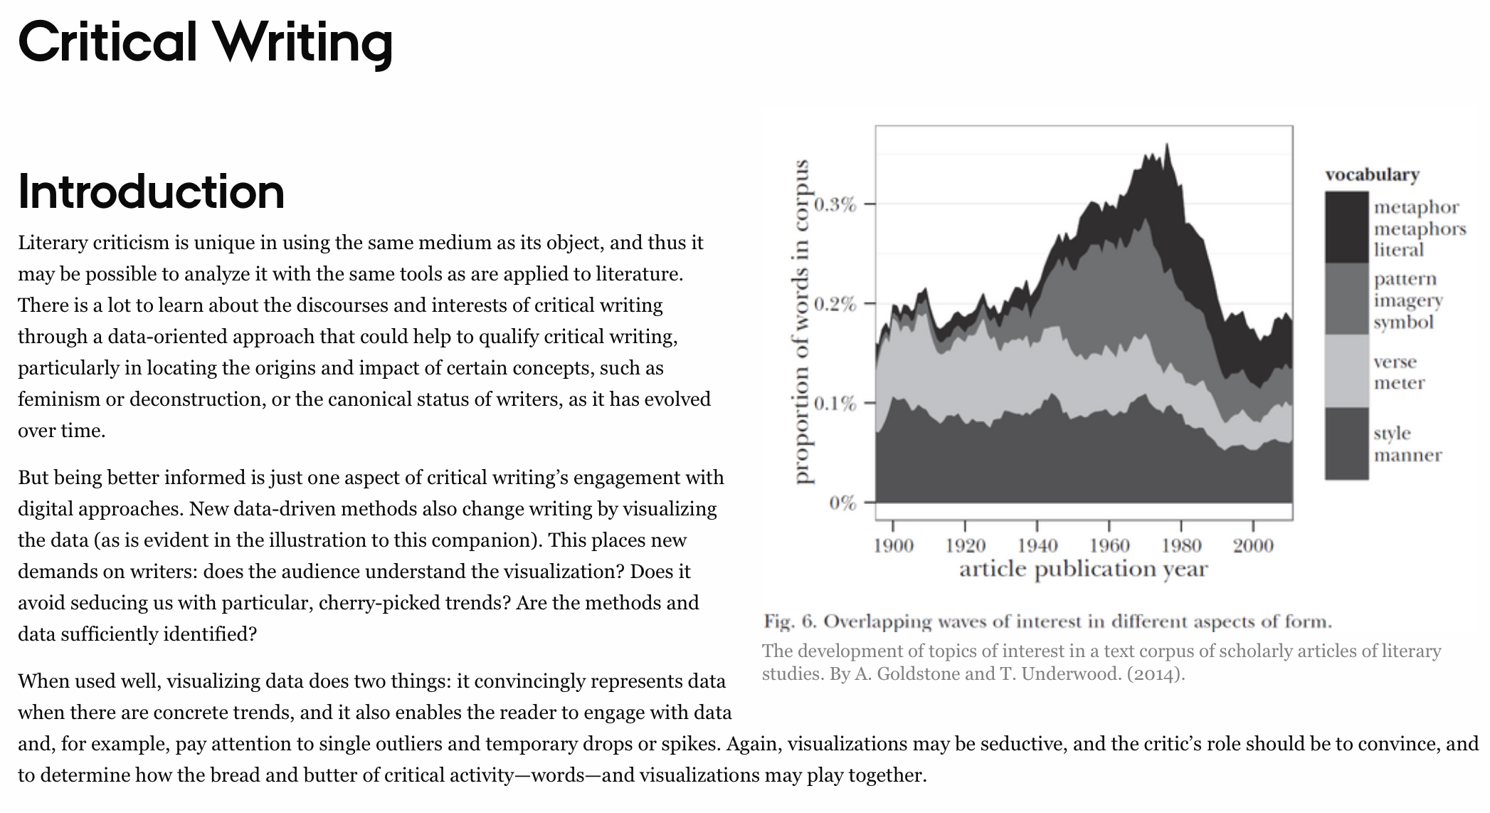
Nyt pilotprojekt om
Computationelle metoder i Dansk

Slide 17
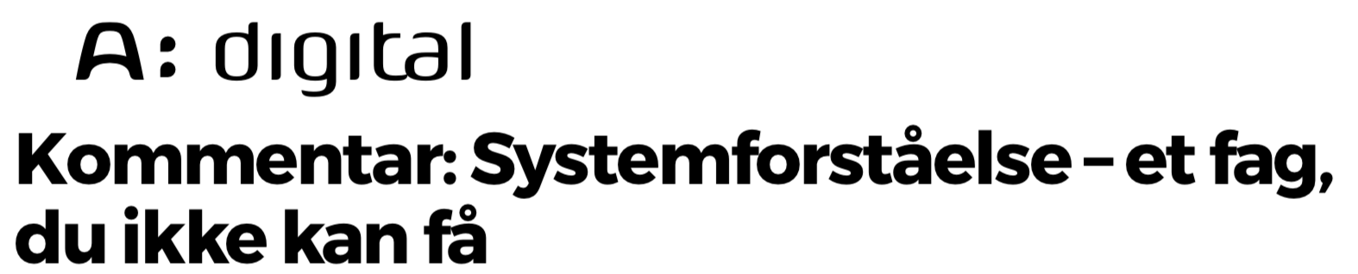
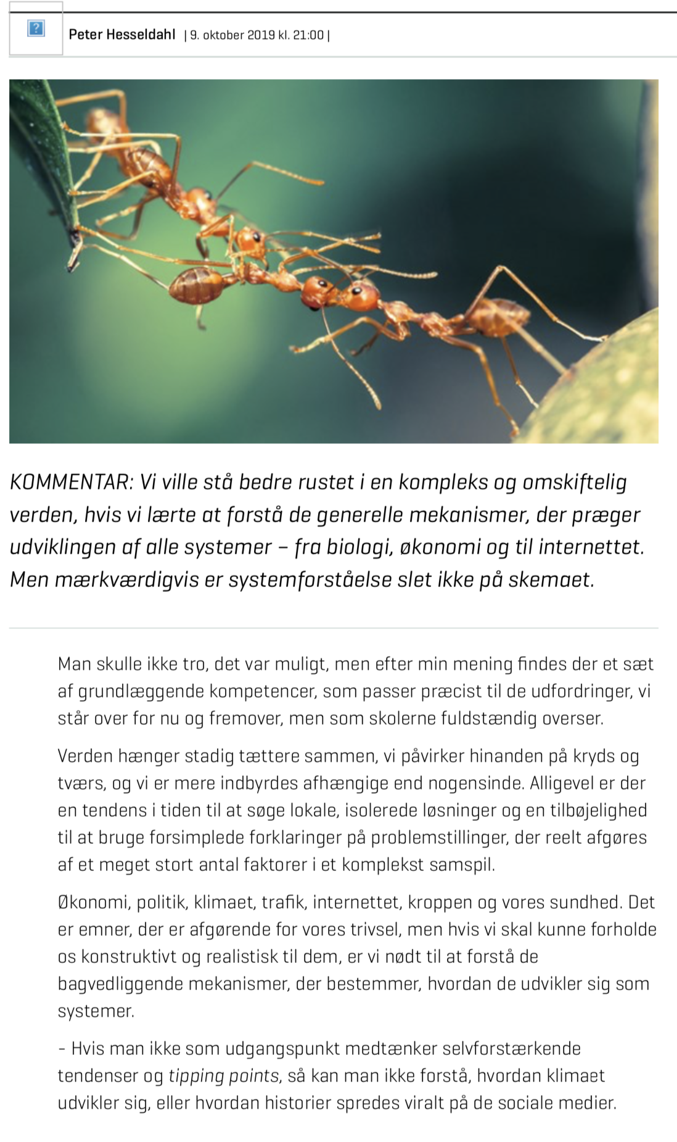
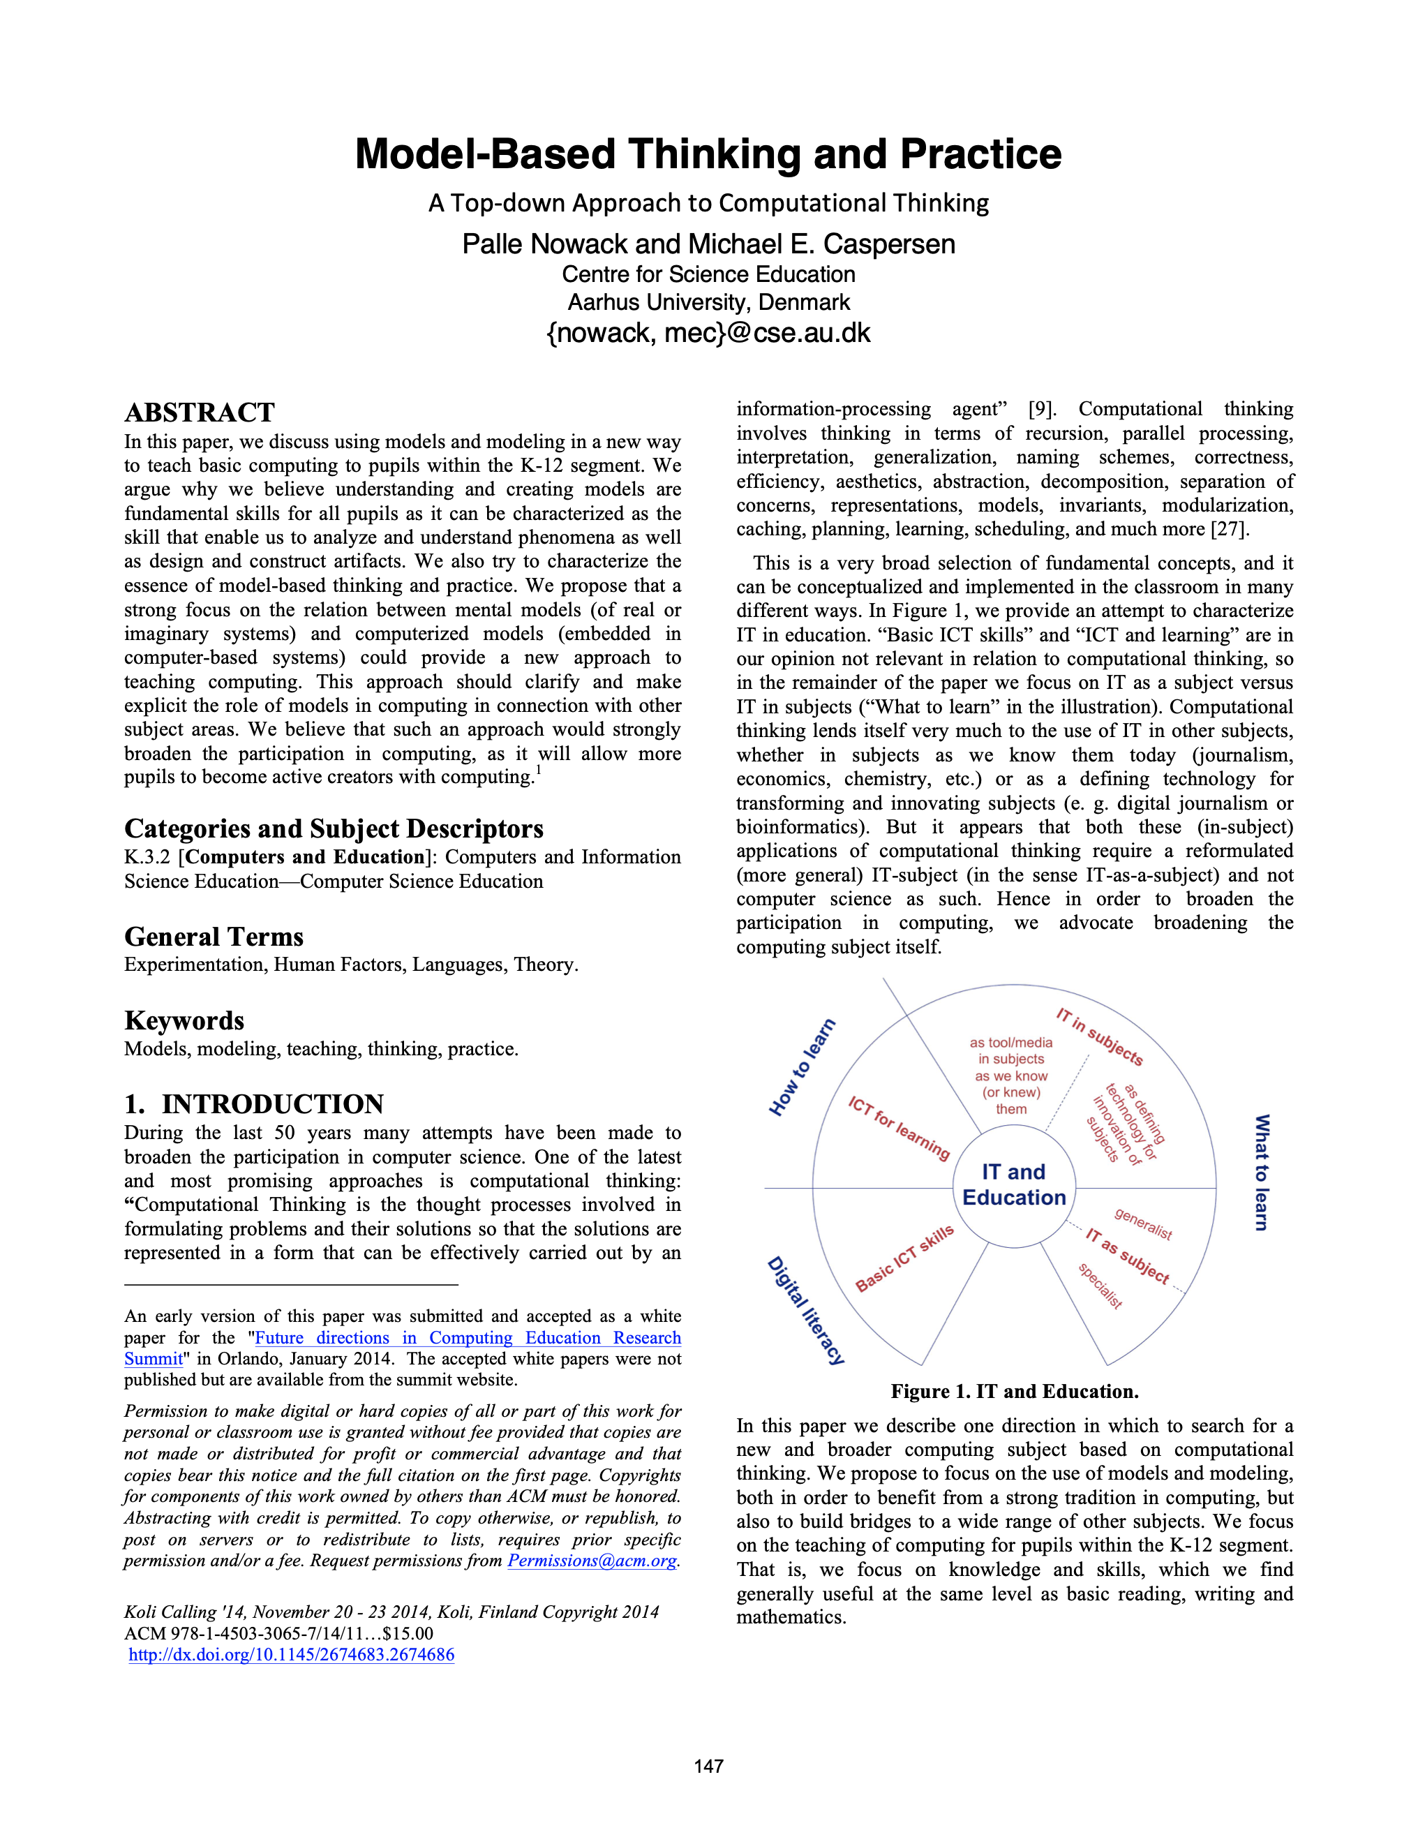
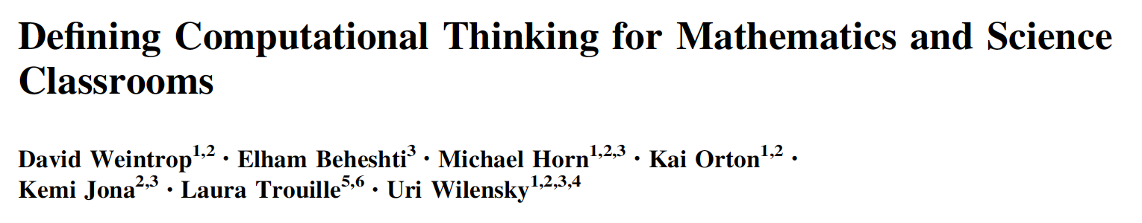
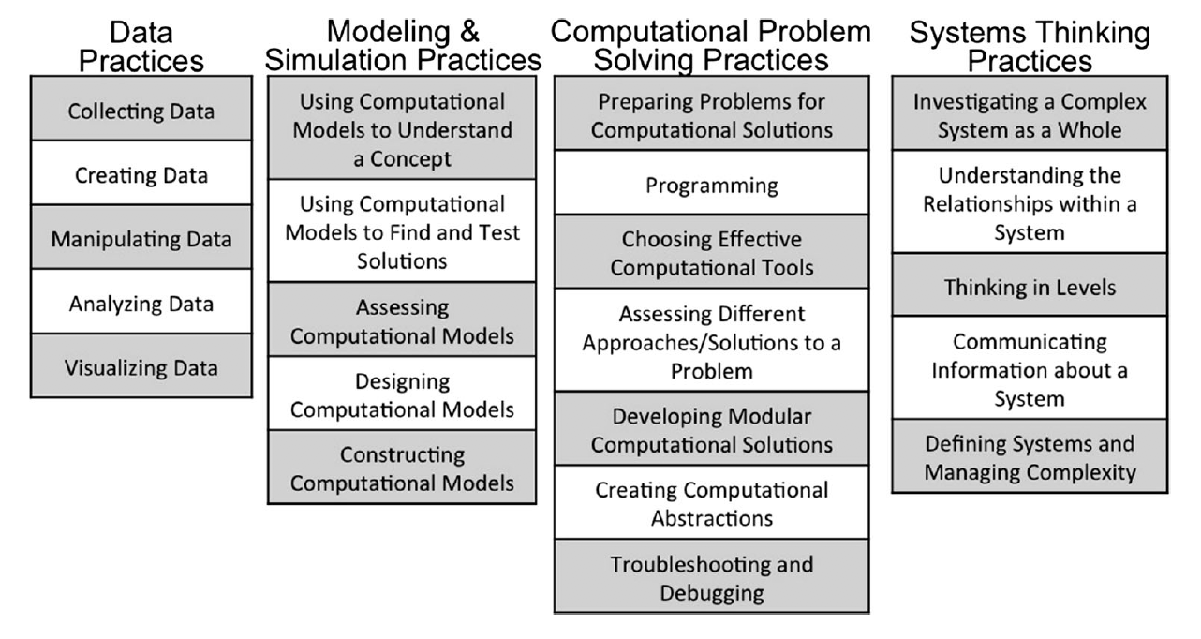
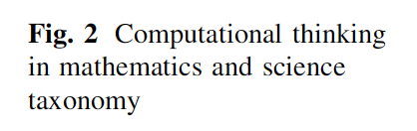
Skriftsprog og matematik
Statisk og deskriptivt (analogt)
Lukket (matematik) ...
Computationelt sprog
Dynamisk og generativt (digitalt)
Åbent...
Notes:
Computational language has evolved because it enables simple, generative description of processes – and because we have developed machines, that can execute such descriptions.
Thus, a computational literacy enables model-based thinking and practice in all subjects, thereby opening the gate to an entirely new dimension for investigation, modelling and comprehension of subject matter knowledge in any discipline. And it opens the gate to a more holistic systems thinking approach early in school.
Also, computational language enables a radical new form of creative expression.

Slide 18
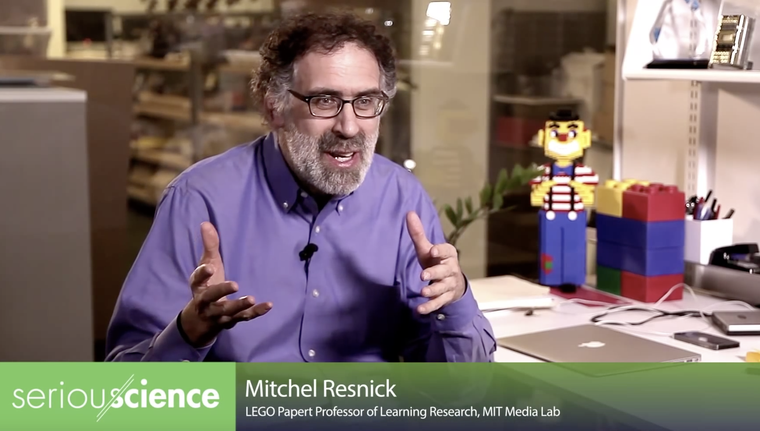
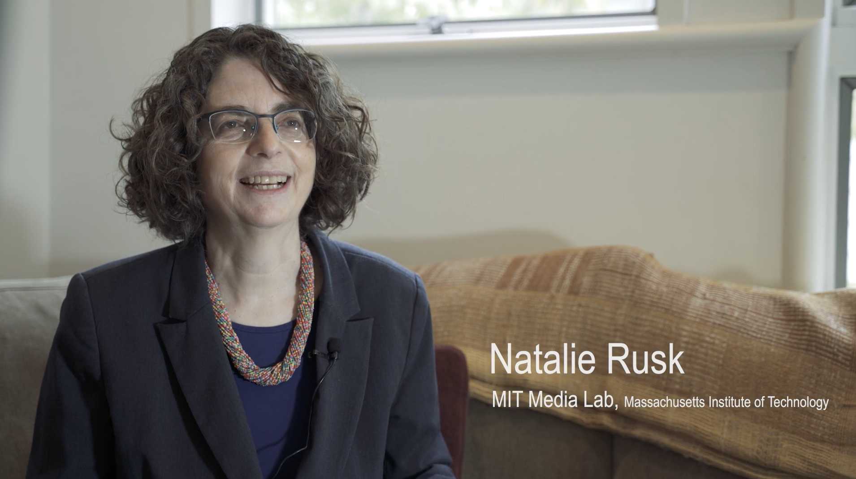
Computational Literacy/Fluency
Two videos from the Lifelong Kindergarten group @ MIT Media Lab
Coding is a new way for people to share ideas with the world
– an extended form of writing.
Like we learn to write and write to learn, we must learn to code and code to learn
Notes:
People in our community pinpoints this analogy to written language.
Mitch Resnick, for example, sees coding as a new way for people to share ideas with the world – an extended form of writing.
As Resnick says: Like we learn to write and write to learn, we must learn to code and code to learn.

Slide 19

Computational thinking – at tænke med maskiner
er en podcast-serie fra It-vest om informatik og brugen af computationelle metoder i forskning og uddannelse.
I podcast-serien undersøger vi, hvordan såkaldte computationelle metoder kan spille en rolle i forskning, fra fysik over antropologi til litteraturvidenskab.
Den primære målgruppe for podcast-serien er gymnasielærere og -elever, men serien er i øvrigt relevant for alle med interesse for den digitale udvikling i samfundet og specielt inden for uddannelse og forskning i alle fag.
Der er 12 episoder fra de to første sæsoner, men flere er på vej. Lyt med og bliv overrasket, informeret og nysgerrig på mere...

Slide 20
Bonus slides

